Slide 1
Fits & Tolerances

Slide 2
Tolerance Dimensioning
Tolerance is the total amount that a specific dimension is permitted to vary; Or, paraphrased… “Tolerance is how accepting of errors you are”.
It is the difference between the maximum and the minimum limits for the dimension.
For Example a dimension given as 1.625 ± .002 means that the manufactured part may be 1.627” or 1.623”, or anywhere between these limit dimensions.

Slide 3
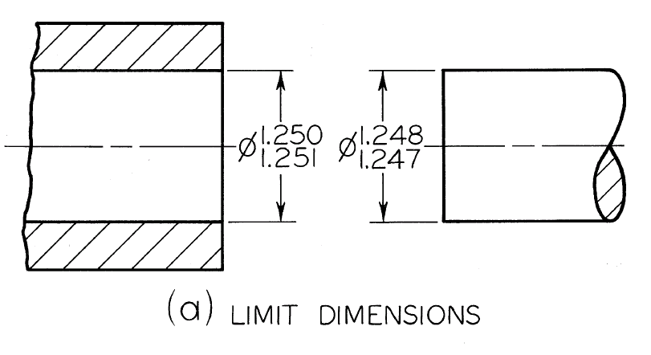
Tolerances
The Tolerance is 0.001” for the Hole as well as for the Shaft

Slide 4
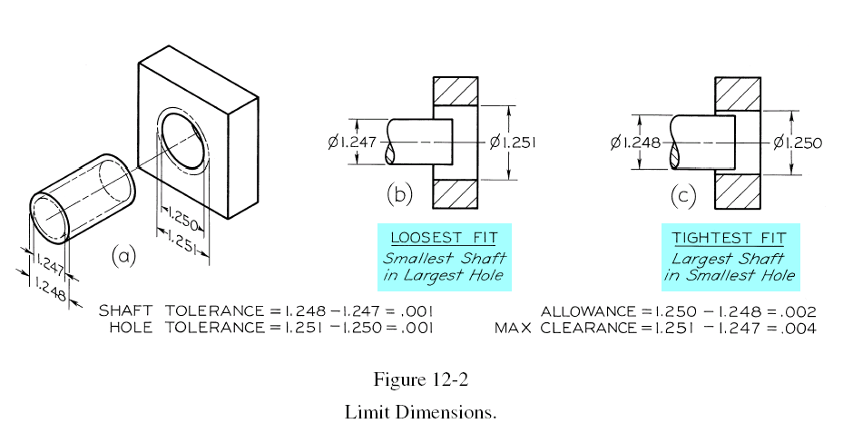
Allowance & Clearance
Interchangeable Fit

Slide 5
Size Designations
Nominal Size: It is the designation used for general identification and is usually expressed in common fractions. For Ex. In the previous figure, the nominal size of both hole and shaft, which is 11/4” would be 1.25” in a decimal system of dimensioning.
Basic Size or Basic dimension: It is the theoretical size from which limits of size are derived by the application of allowances and tolerances.
Actual Size: is the measured size of the finished part.
Allowance: is the minimum clearance space (or maximum interference)intended between the maximum material condition of mating parts.

Slide 6
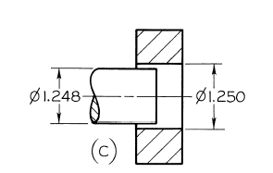
Fits Between Mating Parts
Fit is the general term used to signify the range of tightness or looseness that may result from the application of a specific combination of allowances and tolerances in mating parts.
There are four types of fits between parts
Clearance Fit: an internal member fits in an external member (as a shaft in a hole) and always leaves a space or clearance between the parts.
Minimum air space is 0.002”. This is the allowance and is always positive in a clearance fit

Slide 7
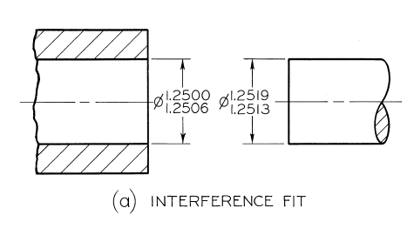
Interference Fit: The internal member is larger than the external member such that there is always an actual interference of material. The smallest shaft is 1.2513” and the largest hole is 1.2506”, so that there is an actual interference of metal amounting to at least 0.0007”. Under maximum material conditions the interference would be 0.0019”. This interference is the allowance, and in an interference fit it is always negative.

Slide 8
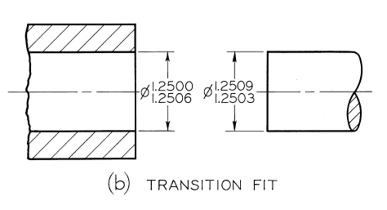
Transition Fit: may result in either a clearance or interference condition. In the figure below, the smallest shaft 1.2503” will fit in the largest hole 1.2506”, with 0.003” to spare. But the largest shaft, 1.2509” will have to be forced into the smallest hole, 1.2500” with an interference of metal of 0.009”.

Slide 9
Line Fit: the limits of size are so specified that a clearance or surface contact may result when mating parts are assembled.

Slide 10
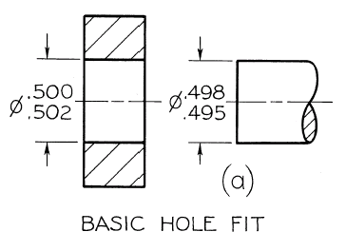
Basic Hole System
Minimum hole is taken as the basic size, an allowance is assigned, and tolerances are applied on both sides of and away from this allowance.
The minimum size of the hole 0.500” is taken as the basic size.
An allowance of 0.002” is decided on and subtracted from the basic hole size, making the maximum shaft as 0.498”.
Tolerances of 0.002” and 0.003” respectively are applied to the hole and shaft to obtain the maximum hole of 0.502” and the minimum shaft of 0.495”.
Minimum clearance: 0.500”-0.498” = 0.002”
Maximum clearance: 0.502” – 0.495” = 0.007”

Slide 11
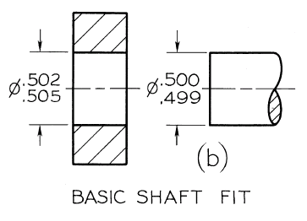
Basic Shaft System
Maximum shaft is taken as the basic size, an allowance is assigned, and tolerances are applied on both sides of and away from this allowance.
The maximum size of the shaft 0.500” is taken as the basic size.
An allowance of 0.002” is decided on and added to the basic shaft size, making the minimum hole as 0.502”.
Tolerances of 0.003” and 0.001” respectively are applied to the hole and shaft to obtain the maximum hole of 0.505” and the minimum shaft of 0.499”.
Minimum clearance: 0.502”-0.500” = 0.002”
Maximum clearance: 0.505” – 0.499” = 0.006”

Slide 12
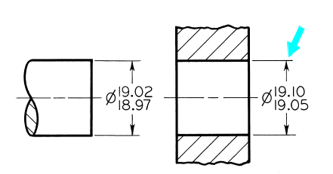
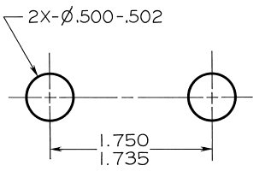
Specifications of Tolerances
Limit Dimensioning
The high limit is placed above the low limit.
In single-line note form, the low limit precedes the high limit separated by a dash

Slide 13
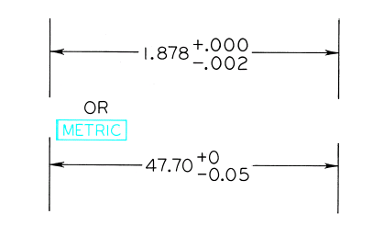
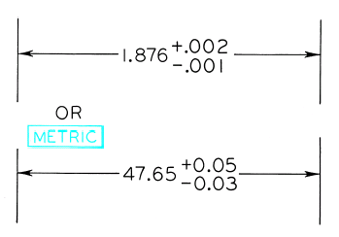
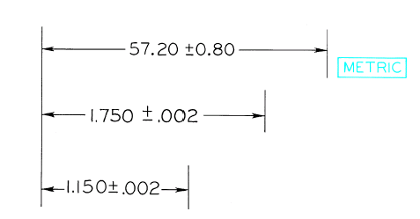
Specifications of Tolerances
Plus-or-minus Dimensioning
Unilateral Tolerance
Bilateral Tolerance

Slide 14
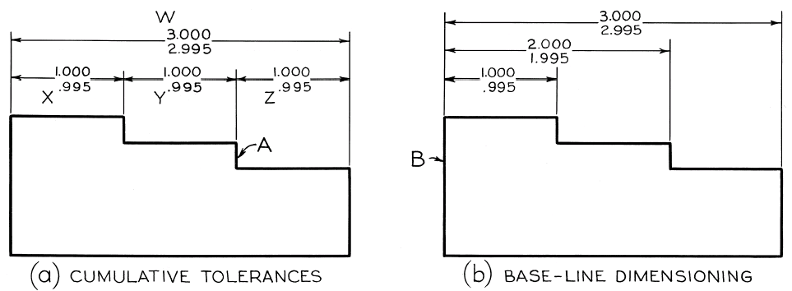
Cumulative Tolerances

Slide 15
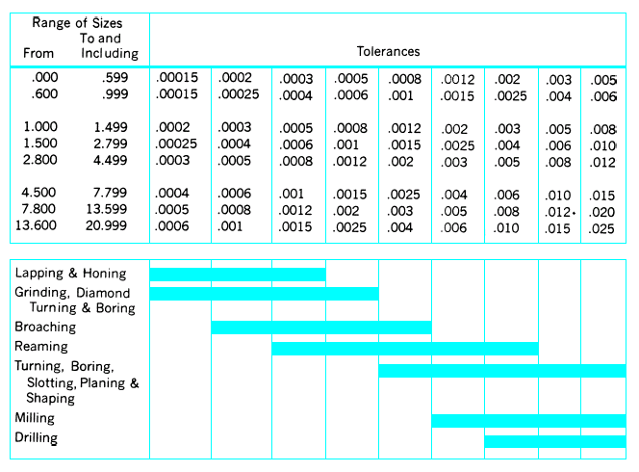
Tolerances Related to Machining Processes

Slide 16
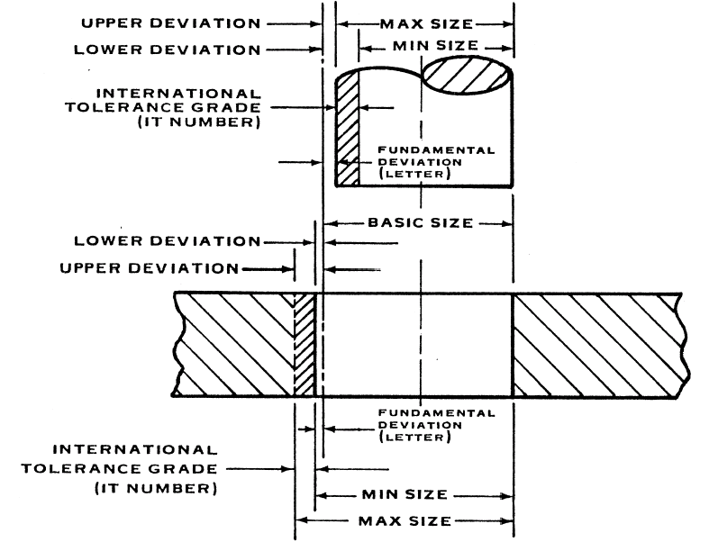
Terms related to Metric Limits & Fits

Slide 17
Some Definitions
Basic Size: is the size from which limits or deviations are assigned. Basic sizes, usually diameters, should be selected from a table of preferred sizes.
Deviation: is the difference between the basic size and the hole or shaft size.
Upper Deviation: is the difference between the basic size and the permitted maximum size of the part.
Lower Deviation: is the difference between the basic size and the minimum permitted size of the part.

Slide 18
Some Definitions
Fundamental Deviation: is the deviation closest to the basic size.
Tolerance: is the difference between the permitted minimum and maximum sizes of a part.

Slide 19
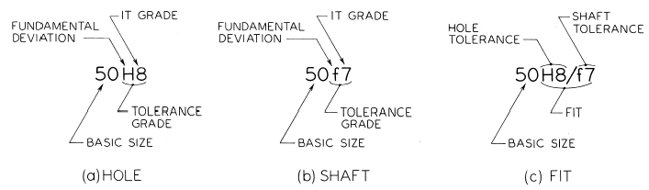
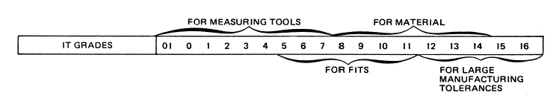
International Tolerance Grade (IT):
They are a set of tolerances that varies according to the basic size and provides a uniform level of accuracy within the grade.

Slide 20
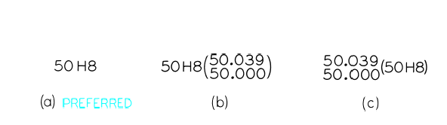

Slide 21
Definitions
Tolerance Zone: refers to the relationship of the tolerance to basic size. It is established by a combination of the fundamental deviation indicated by a letter and the IT grade number. In the dimension 50H8, for the close running fit, the H8 specifies the tolerance zone.
The hole-basis system of preferred fits is a system in which the basic diameter is the minimum size. For the generally preferred hole-basis system, the fundamental deviation is specified by the upper-case letter H.

Slide 22
The shaft-basis system of preferred fits is a system in which the basic diameter is the maximum size of the shaft. The fundamental deviation is given by the lowercase letter h.
An interference fit results in an interference between two mating parts under all tolerance conditions.

Slide 23
A transition fit results in either a clearance or an interference condition between two assembled parts.

Slide 24
Tolerance symbols are used to specify the tolerance and fits for mating parts. For the hole-basis system ,the 50 indicates the diameter in millimeters; the fundamental deviation for the hole is indicated by the capital letter H, and for the shaft it is indicated by the lowercase letter f. The numbers following the letters indicate this IT grade. Note that the symbols for the hole and shaft are separated by the slash. Tolerance symbols for a 50-mm-diameter hole may be given in several acceptable forms. The values in parentheses for reference only and may be omitted.

Slide 25
